Slide 1
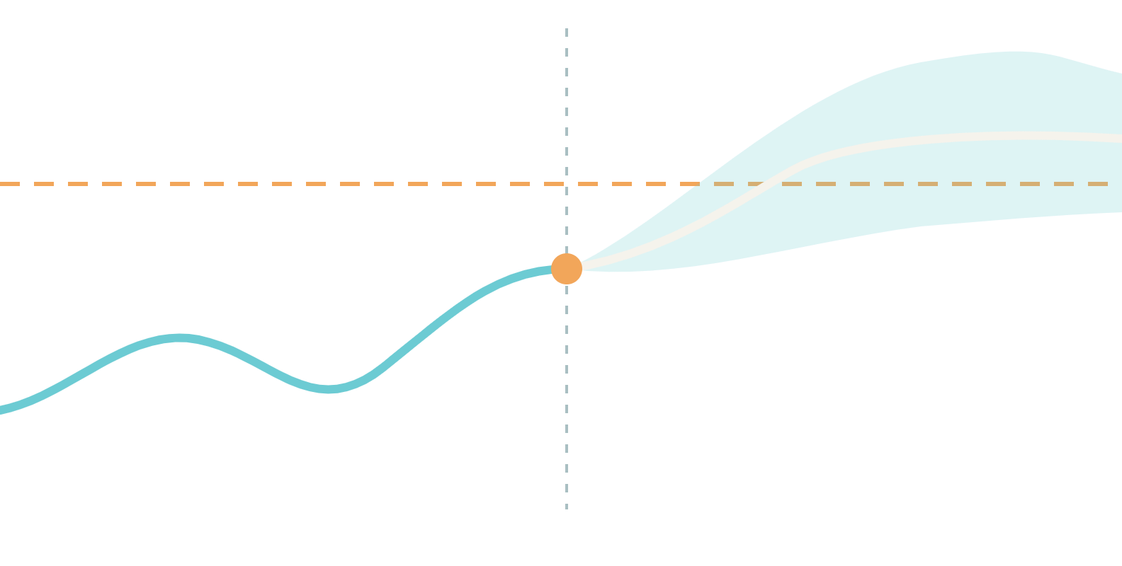
Glucose Digital Twin
DIGITAL TWIN IN HEALTHCARE · PHASE 1 PROTOTYPE
Predicting glucose excursions two hours ahead for Indian adults with prediabetes and type 2 diabetes
180 mg/dL
[Team name] · [College or incubator]
Proof of concept: a patient’s record and wearable data fused in one model
now
next 2 hours
Notes:
Good [morning or afternoon]. We are [Team name] from [College or incubator], and this is our proof-of-concept digital twin for glucose. In India, an estimated 101 million people live with diabetes and another 136 million with prediabetes, yet glucose is usually seen in snapshots: a clinic reading here, a lab value there. Our twin joins a patient’s electronic health record with their wearable data and warns, two hours ahead, when glucose is likely to rise above 180 milligrams per decilitre. Over the next twenty minutes we will cover the problem, the data, the architecture, how we evaluate honestly, the doctor dashboard, and what comes next. One promise up front: every number you see comes from code in our public repository, and anything we have not run is marked as such.

Slide 2
India’s diabetes burden
PROBLEM
DIABETES
Focus
PREDIABETES
Focus
HYPERTENSION
Context
101
136
315
million people
million people
million people
11.4% prevalence
15.3% prevalence
35.5% prevalence
Prediabetes is the prevention window: 136 million people sit one step from diabetes.
Source: ICMR–INDIAB, Lancet Diabetes & Endocrinology 2023; 113,043 people surveyed.
Notes:
Start with scale. The ICMR–INDIAB national survey, published in The Lancet Diabetes and Endocrinology in 2023, estimated 101 million people in India with diabetes, a prevalence of 11.4 percent, and another 136 million with prediabetes, 15.3 percent. It also estimated 315 million people with hypertension, which shows how much of the burden is chronic and metabolic. The survey covered 113,043 people across the country. These figures are summarised in a 2023 commentary in the National Medical Journal of India. We focus on glucose, because prediabetes is the prevention window. These 136 million people do not yet have diabetes, so earlier feedback on how their glucose behaves day to day could change what they eat and how they move. The same logic holds for people who already have type 2 diabetes. The question for our project is simple: can we see trouble coming before it arrives?

Slide 3
The care gap
PROBLEM
Clinic visit
HbA1c
Wearables and CGM
One reading at one moment. Spikes between visits go unseen.
An average over roughly 2 to 3 months. It hides how high and how often glucose spikes.
Continuous signals, kept apart from the medical record.
A digital twin joins the record and the stream in one model of the patient.
<7%
of people with self-reported diabetes met combined ABC control: HbA1c, blood pressure and cholesterol targets together (an earlier ICMR–INDIAB analysis)
Source: Natl Med J India 2023;36:137–9, citing an earlier ICMR–INDIAB analysis.
Notes:
Three things keep us blind to what glucose actually does. A clinic visit gives one reading at one moment. HbA1c summarises roughly the last two to three months, so it can look acceptable while spikes happen after meals. And wearables and continuous glucose monitors give a continuous stream, but that stream usually stays apart from the medical record. The effect shows up in outcomes. An earlier ICMR–INDIAB analysis, cited in a 2023 commentary, found that fewer than 7 percent of people with self-reported diabetes had HbA1c, blood pressure and cholesterol all on target together. We are not claiming our tool fixes that. We are claiming that joining the record with the stream gives a doctor something they do not have today: a forward-looking view of one patient. That joined view is what we mean by a digital twin.

Slide 4
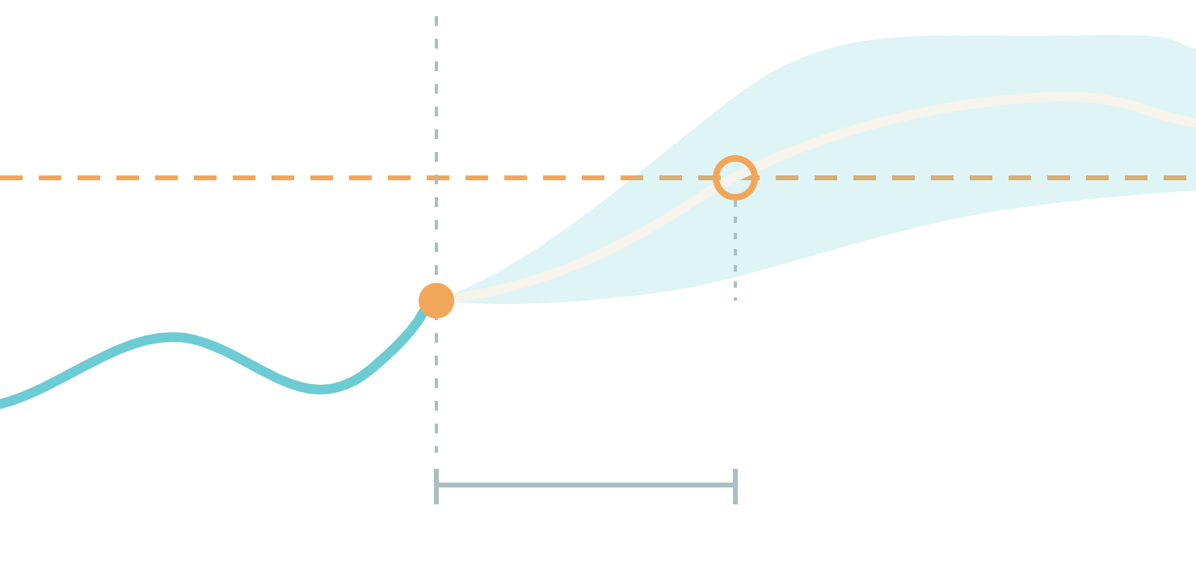
The prediction target
USE CASE
now
For a patient whose glucose is below 180 mg/dL now, will it rise above 180 mg/dL at any point in the next 2 hours?
180 mg/dL
alert
event
lead time
window: 120 min
EVENT
ALERT
WHO ACTS
First reading above 180 mg/dL after at least 60 minutes below it.
Counts as detected if raised 15 to 120 minutes before the event.
The clinician and the patient, through meal, walk or timing choices.
Notes:
This is the single question our twin answers. For a patient whose glucose is below 180 milligrams per decilitre right now, will it rise above 180 at any point in the next two hours? 180 is the upper edge of the 70 to 180 range that continuous glucose monitor reports use for time in range, so a crossing is a clinically familiar event. We define the event precisely so that results are honest: the first reading above 180 after at least an hour below it. An alert counts as a detection only if it fired between 15 and 120 minutes before that event, because a warning that arrives after the spike, or too early to matter, is not useful. The people who act are the clinician and the patient, through choices about the next meal, a walk, or dinner time. We only score moments when glucose is currently below 180, so the model has to warn about a new excursion rather than echo one that is already happening. The drawing is a schematic, not data.

Slide 5
Two data streams, one patient
DATA
STATIC STREAM
changes slowly
DYNAMIC STREAM
changes by the minute
Electronic health record
Wearables and IoT sensors
Age, sex and BMI
Past diagnoses and comorbidities
HbA1c, fasting glucose, insulin, lipids
Medications
Genetic markers
CGM glucose
Heart rate
Steps and activity
Sleep stages and HRV
Meal logs and macros
Every prediction uses both streams.
Notes:
The challenge asks us to fuse two kinds of data, and we kept that fusion at the centre of the design. The static stream is the electronic health record: demographics, past diagnoses and comorbidities, laboratory results such as HbA1c, fasting glucose, insulin and lipids, medications, and genetic markers. It changes slowly, but it tells the model who the patient is. The dynamic stream comes from wearables and IoT devices: continuous glucose readings, heart rate, steps and activity, sleep stages and heart-rate variability, and meal logs with their carbohydrate, protein and fat content. It changes minute by minute and tells the model what is happening now. Real datasets rarely contain every signal. The open data we use has glucose, heart rate, activity and meals, but not always sleep, HRV or genetic markers. Our synthetic generator fills those gaps for demonstration, and our evaluation only compares models on the signals each dataset truly has.

Slide 6
Open datasets and the sandbox
DATA
Dataset | People | Signals | Role
CGMacros | 45 adults: 15 healthy, 16 prediabetes, 14 type 2 diabetes | Dexcom and Libre CGMs, Fitbit heart rate and METs, meal macros, baseline labs; 10 days | Main training and evaluation
BIG IDEAs | 16 participants | Dexcom G6 CGM, Empatica E4 wristband, food logs; 8–10 days | External check
ShanghaiT2DM | 100 people with type 2 diabetes | CGM, diet logs, labs, medications; 3–14 days | Optional T2D cohort
Synthetic generator | Virtual patients with Indian-profile priors | EHR, CGM, heart rate, steps, sleep, HRV, Indian meals | Demo, tests, what-if checks only
Sandbox rule: only anonymised, open-source or synthetic data are used (DPDP Act, HIPAA).
Sources: PhysioNet (CGMacros v1.0.0; BIG IDEAs v1.1.3); Zhao et al., Scientific Data 2023 (ShanghaiT2DM).
Notes:
These are the datasets behind the project, and the sandbox rule that governs them: only anonymised, open-source or synthetic data, in line with India’s DPDP Act and with HIPAA. CGMacros from PhysioNet is our main dataset: 45 adults, 15 healthy, 16 with prediabetes and 14 with type 2 diabetes, who wore two continuous glucose monitors and a Fitbit for ten days and logged meals with their macronutrients. It also has baseline lab results. BIG IDEAs gives us a second cohort with a different sensor stack, a Dexcom G6 and an Empatica E4 wristband, which we use as an external check. ShanghaiT2DM adds 100 people with type 2 diabetes, with labs, medications and diet logs, and is optional for us. Finally there is our own synthetic generator, with Indian-profile priors and Indian meals, which we use for the demo, for tests and for what-if checks, never for headline metrics. We return to the licence terms near the end.

Slide 7



System architecture
BUILD
Privacy boundary
Only anonymised, open or synthetic data
Digital twin core
Patient state
EHR embedding plus fitted physiology, updated per reading
Static: EHR
Demographics, diagnoses, labs, medications, genetic markers
Harmonise
Common schema
5-minute grid
mg/dL units
Quality checks
Past-only features
Fusion forecaster
Doctor dashboard
Risk, time to crossing, trajectory band, drivers
Risk, drivers, what-if
Dynamic: wearables
CGM, heart rate, steps, sleep, HRV, meal logs
What-if engine
Meal swap, post-meal walk, dinner shift
Notes:
Here is the whole system on one page. On the left, inside a dashed privacy boundary, are the two streams: the static electronic health record and the dynamic wearable stream. Nothing crosses that boundary unless it is anonymised, open or synthetic. Both streams enter a harmonise step that maps everything to one schema on a five-minute grid, converts units to milligrams per decilitre, runs quality checks, and builds features using only past data, so the model can never see the future. The digital twin core has three parts. The patient state is a persistent profile that updates with every new reading. The fusion forecaster reads both streams and produces the risk, the time to crossing, a trajectory with an uncertainty band, and the drivers. The what-if engine re-runs the forecast for a different meal, walk or dinner time. The output is the doctor dashboard, which we show later. A standalone version of this diagram is part of our submission.

Slide 8
The twin core
BUILD
COMPONENT 1
COMPONENT 2
COMPONENT 3
Patient state
Fusion forecaster
What-if engine
A persistent profile for each patient: an EHR embedding plus fitted physiology.
Reads both streams and forecasts glucose for the next two hours.
Re-runs the forecast for a changed meal, walk or dinner time.
Meal-response gain and delay
Baseline glucose
Insulin-sensitivity proxy
Sync status and completeness
Probability of crossing 180 mg/dL
Estimated time to crossing
Trajectory with 10–90% band
Top drivers in plain English
Counterfactual glucose curve
Change in predicted peak
Change in risk
Assumption label on each effect
Notes:
The twin core has three components, and each one has a clear job. The patient state is what makes this a twin rather than a one-off model. It holds an embedding of the patient’s record together with a few physiological parameters that we fit for that individual: how strongly and how quickly their glucose responds to a meal, their baseline glucose, and an insulin-sensitivity proxy. It updates with every new reading, and it reports its own sync status, so a doctor can see how fresh and how complete the twin is. The fusion forecaster reads both streams and gives a calibrated probability of crossing 180, an estimate of when, a glucose trajectory with a ten to ninety percent band, and the top drivers in plain English. The what-if engine reuses the forecaster and the patient state to answer questions such as: what if this dinner were earlier, or followed by a walk? It shows the change in the predicted peak and in risk, and it labels every assumption it makes.

Slide 9
Fusion features
BUILD
Group | What it captures | Examples
CGM | Glucose level and momentum | Level; 15, 30 and 60-minute slopes; rolling mean, SD and CV over 1, 3 and 6 hours
Meals | Carbohydrate load and timing | Time since last meal; carbs, protein, fat, fibre and kcal of the last meal and the last 2 hours
Wearables | Activity, heart rate, recovery | Steps and METs over 30, 60 and 180 minutes; heart rate against the personal baseline; sleep and HRV where available
EHR | Who the patient is | Age, BMI, HbA1c, fasting glucose and insulin, lipids, medications, diagnoses, genetic risk
Twin state | Personal physiology | Fitted response gain and delay, baseline glucose, insulin-sensitivity proxy (from past data only)
Each dataset declares the groups it provides, and every ablation uses only those groups.
Notes:
Features are grouped so that we can measure what each stream adds. CGM features describe the glucose level and its momentum: the current value, slopes over 15, 30 and 60 minutes, and rolling mean, standard deviation and coefficient of variation over one, three and six hours. Meal features capture the carbohydrate load and its timing: time since the last meal, and the macronutrients of that meal and of the last two hours. Wearable features cover steps and METs, heart rate against the person’s own resting baseline, and sleep and HRV where a dataset has them. EHR features are the static profile: age, BMI, labs, medications, diagnoses and genetic risk. Finally, twin-state features are the personal physiology parameters fitted from the patient’s own past data only. Because the open datasets differ in what they contain, each dataset declares which groups it provides, and every ablation uses only those groups.

Slide 10
Evaluation protocol
BUILD
1
Label
Positive if glucose exceeds 180 mg/dL at any point in the next 120 minutes. Scored only when glucose is below 180 now and at least 80% of readings are present.
2
No leakage
Features use only data stamped at or before the decision time. Scalers, imputers, thresholds and calibrators are fit on training patients only.
3
Patient-wise splits
Leave-one-patient-out, or grouped 5-fold when a dataset has more than 60 patients, so no patient appears in both training and test.
4
Alert policy
Probabilities are calibrated. The alert threshold is set on training patients for a target false-alert rate, with a 60-minute cooldown after each alert.
5
Metrics
PR-AUC against prevalence, ROC-AUC, Brier score, calibration, sensitivity at a fixed false-alert rate and event-level detection, each with a 95% CI from a patient-level bootstrap.
Notes:
Honest evaluation is where many health-AI projects fall down, so we fixed the protocol before looking at any result. First, the label: positive if glucose exceeds 180 at any point in the next 120 minutes, and we only score moments where glucose is below 180 now and at least 80 percent of readings in the window are present. Second, no leakage. Features use only past data, and every scaler, imputer, threshold and calibrator is fit on training patients only. We test this by perturbing the future and checking that the features do not change. Third, splits are by patient: leave-one-patient-out on the small cohorts, grouped five-fold when a dataset has more than 60 patients, so no patient is ever in both training and test. Fourth, alerts. Probabilities are calibrated, the threshold is chosen on training patients to meet a target false-alert rate, and a 60-minute cooldown prevents repeated warnings. Fifth, metrics, each with a 95 percent confidence interval from a bootstrap over patients.

Slide 11
Headline results
EVIDENCE
Pending: fill from results/metrics.json
PR-AUC
SENSITIVITY
LEAD TIME
EVENTS DETECTED
[__]
[__%]
[__]
[__%]
against a prevalence of [__]
at [__] false alerts per patient-day
median minutes of warning before the excursion
of excursions had an alert 15 to 120 minutes ahead
Evaluated on CGMacros (45 patients) with leave-one-patient-out; intervals are 95% CIs from a patient-level bootstrap.
Notes:
[Fill in after your real-data run, then delete the Pending tag.] These four numbers come straight from results/metrics.json, produced by the evaluation code and never typed by hand. Read them in this order. First, PR-AUC against the prevalence line: say what fraction of moments are positive and how far above that the model sits, with the confidence interval. Second, sensitivity at the fixed false-alert rate: of the excursions, how many does the alert catch when we allow only this many false alerts per patient-day. Third, the median lead time: how many minutes of warning a clinician or patient gets. Fourth, events detected: the share of real excursions that had an alert between 15 and 120 minutes beforehand. Be candid about the size of the cohort and the width of the intervals. If a number is modest, say so. The contribution is a transparent, reproducible pipeline and an honest evaluation, not a record score.

Slide 12
Fusion ablation
EVIDENCE
Pending: fill from results/ablation.csv
ID | Model | Data used | PR-AUC | Sens.* | Brier
B0 | Trend baseline | Last 30 min of glucose | [__] | [__] | [__]
B1 | CGM only | CGM | [__] | [__] | [__]
B2 | + meals | CGM + meals | [__] | [__] | [__]
B3 | + wearables | CGM + meals + wearables | [__] | [__] | [__]
B4 | + EHR | CGM + meals + EHR | [__] | [__] | [__]
B5 | Full fusion | CGM + meals + wearables + EHR | [__] | [__] | [__]
B6 | + twin state | B5 + fitted physiology | [__] | [__] | [__]
*Sens. = sensitivity at a fixed false-alert rate. Values from results/ablation.csv, with 95% CIs.
Notes:
[Fill in after your real-data run, then delete the Pending tag.] This table is the evidence for the central requirement of the challenge: that fusing the two data streams helps. Every row uses the same patient-wise splits, and every model past B0 is the same LightGBM learner, so the only thing that changes is the data it sees. B0 is a simple trend extrapolation of the last 30 minutes, the baseline any model has to beat. B1 uses glucose alone. B2 adds meals. B3 adds the dynamic wearable stream. B4 adds the static health record instead. B5 combines everything, and B6 adds the twin-state features fitted from the patient’s own history. Read the table honestly. Say which additions helped, by how much, and whether the confidence intervals overlap. If an addition did not help on this cohort, say that too, and what you think the reason is. [Note: use only the groups each dataset actually contains.]

Slide 13
Alerts in practice
EVIDENCE
Pending: fill from results/metrics.json
Event-level detection
[__%]
of excursions detected 15 to 120 minutes ahead
Calibration curve
Insert results/figures/calibration.png
[__]
false alerts per patient-day
[__]
minutes of median lead time
Predicted probability against observed frequency, pooled out-of-fold predictions.
Notes:
[Fill in after your real-data run, then delete the Pending tag.] Two questions here. First, are the probabilities trustworthy? The calibration curve on the left compares predicted probability with how often excursions actually happened. A curve near the diagonal means a 30 percent warning really is about 30 percent. We calibrate on training patients only. Second, does the alert work as an alert? On the right are the event-level numbers, which matter more to a clinician than AUC: how many real excursions were caught with a warning 15 to 120 minutes ahead, how many false alerts a patient would see per day, and the median lead time. State the false-alert budget you chose and why, and mention the 60-minute cooldown that stops repeated warnings. If detection differs between groups, such as healthy participants, people with prediabetes and people with type 2 diabetes, show the per-cohort breakdown from results/metrics.json and say what it means.

Slide 14
Explaining each alert
EVIDENCE
Pending: fill from results/figures
Drivers in plain English
EXAMPLE FORMAT
Risk is [__]% because the last meal had [__] g of carbohydrate [__] minutes ago and glucose is rising [__] mg/dL per 15 minutes.
SHAP summary
Insert results/figures/shap_summary.png
Drivers come from SHAP values and are worded the same way in the dashboard risk card.
Which features push predicted risk up or down, across all predictions.
Notes:
[Fill in after your real-data run, then delete the Pending tag.] A doctor will not act on a probability alone, so each alert comes with reasons. The figure on the left is the SHAP summary: across all predictions, which features push risk up or down, and by how much. Point out two or three that make clinical sense, such as recent carbohydrate load, the current glucose slope, or the time since the last meal. If the top feature is something odd, say so, and say what you checked. On the right is how the same information appears for one patient: a plain-English sentence generated from the top SHAP drivers, with the actual values filled in. It reads the same way in the dashboard risk card. One caution to state out loud: this explains the model, not the physiology. A driver tells you what the model used, not what caused the spike.

Slide 15
What-if engine
DOCTOR EXPERIENCE
Swap the meal
Add a walk
Shift dinner
Replace the next meal with a preset Indian meal, such as idli, poha, roti with dal, or rice.
Add a short walk after the meal and see how the predicted peak changes.
Move the dinner time and see how the forecast changes.
The doctor sees
Counterfactual curve
Change in predicted peak
Change in risk
Uncertainty band
A simulation under stated assumptions, not a causal estimate.
Every intervention effect carries a label: illustrative default, fitted from data, or literature (to be verified). On synthetic patients we check the engine against the generator’s ground-truth counterfactuals; error: [__].
Notes:
The what-if engine is where the twin becomes useful in the consultation. A doctor can ask three kinds of question: what if the next meal were different, what if the patient took a short walk afterwards, what if dinner were earlier? The engine re-runs the forecast and shows the counterfactual curve, the change in the predicted peak, the change in risk, and a wider uncertainty band, because we are adding assumptions on top of the model. We want to be careful about what this is. The baseline forecast is learned from data, but the effect of an intervention is a mechanistic adjustment computed from the patient’s fitted parameters and an effect size stored in a configuration file. Every effect carries a label: illustrative default, fitted from data, or literature to be verified. The dashboard shows that label. So this is a simulation under stated assumptions, not a causal estimate. On synthetic patients, where we know the ground truth because we generated it, we compare the predicted effects with the true ones and report the error. [Read it from results/whatif_synthetic.json and replace the bracket on the slide.]

Slide 16
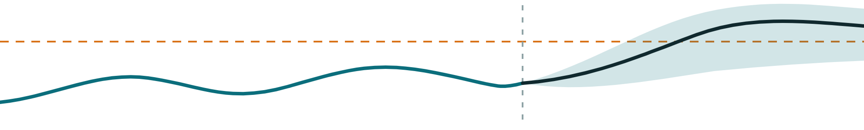
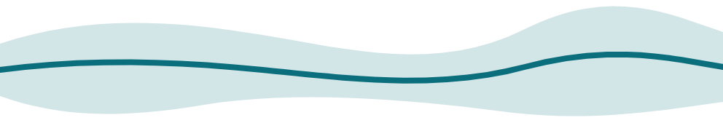
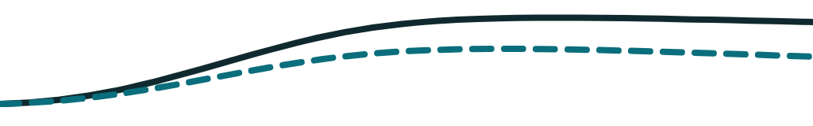
Doctor dashboard
DOCTOR EXPERIENCE · CONCEPTUAL WIREFRAME
1 · Patient header
SYNTHETIC patient
Twin synced [__] min ago
Data [__]% complete
Model v[__]
2 · Glucose and 2-hour forecast
dashed line: 180 mg/dL
3 · Risk, next 2 hours
[__%]
Time to crossing
[__] min
Top drivers
Replay
4 · EHR card
5 · What-if, with assumption label
6 · 14-day glucose profile
Diagnoses
Labs
Medications
Swap meal
Walk
Dinner time
Genetic risk
Past records beside the live stream
Time in range, above 180, below 70
Notes:
This is the conceptual doctor dashboard. It is a wireframe: it shows the layout and what each panel is for, and the values are placeholders. Our working prototype is built in Streamlit and follows the same six panels. Panel 1 is the patient header, with twin sync status, data completeness and model version, so a doctor knows how much to trust what follows. Panel 2 shows the glucose trace with the two-hour forecast band and the 180 line, driven by a replay slider that streams recorded data as if it were live. Panel 3 is the risk card: probability, estimated time to crossing and the top drivers in plain English. Panel 4 shows the record: diagnoses, labs, medications and genetic risk. Panel 5 is the what-if panel, with the assumption label always visible. Panel 6 is a 14-day ambulatory glucose profile with time in range, time above 180, time below 70, mean glucose, GMI and coefficient of variation, a format diabetologists already read. Synthetic patients carry a visible SYNTHETIC banner, and the footer states that this is a research prototype. [Add your own screenshots of the running app on the next slide or in the video.]

Slide 17

Doctor workflow
DOCTOR EXPERIENCE
1
2
3
4
5
Open patient
Review risk
Inspect drivers
Ask what if
Record the plan
Pick a patient. The twin loads the record and live data.
See the risk for the next 2 hours and the forecast band.
Read the reasons behind the alert in plain English.
Test a meal swap, a walk or an earlier dinner.
Note the advice. Writing back to the EHR is future work.
Replay mode
The prototype streams recorded data as if it were live. Every synthetic patient carries a SYNTHETIC label.
Notes:
Here is how a clinician would use the twin in a consultation or a ward round. First, open the patient. The twin loads the health record and the latest wearable data, and shows how fresh that data is. Second, review the risk: the chance of crossing 180 milligrams per decilitre in the next two hours, the estimated time to crossing, and the forecast band. Third, inspect the drivers, so the alert arrives with reasons in plain English and not just a number. Fourth, ask what if: swap the next meal, add a walk or move dinner, and see the effect with its assumption label visible. Fifth, record the plan. In our prototype that last step is a note on screen. Writing it back into the electronic health record is future work, and we say so. In the demo the app runs in replay mode: it streams recorded data as if it were live, and synthetic patients carry a clear SYNTHETIC label.

Slide 18
Limitations and ethics
TRUST
DATA
DATA
DATA
Small cohorts
Domain shift
Synthetic data
The main dataset has 45 adults, so confidence intervals are wide and subgroup results are indicative.
CGMacros was recruited in Santa Barbara, California. Indian diets, drugs and sensors differ, so local validation is essential.
Our generator tests the pipeline and the what-if engine. It says nothing about accuracy on real patients.
MODEL
MODEL
USE
Not causal
Alert fatigue
Not a medical device
What-if answers are simulations under labelled assumptions, not predictions of what will happen to a patient.
A false-alert budget and a 60-minute cooldown cap how often a patient is warned, at some cost in sensitivity.
A research prototype using anonymised and synthetic data only, in line with the DPDP Act and HIPAA. No clinical advice.
Notes:
This is the honest slide. Data. Our main dataset has 45 adults, so confidence intervals are wide and results for each subgroup are only indicative. It was recruited in Santa Barbara, California, so Indian diets, medicines and sensors may behave differently, and we have not tested on Indian patients. Our synthetic generator checks that the machinery works; it tells us nothing about accuracy on real people, so we never quote headline metrics from it. Model. What-if answers are simulations under labelled assumptions, not causal estimates. Alerts must be rare enough to be trusted, so we set a false-alert budget on training patients and add a sixty-minute cooldown. That costs some sensitivity, and we report it. Use. This is a research prototype on anonymised and synthetic data, in line with the DPDP Act and HIPAA. It is not a medical device and it gives no clinical advice.

Slide 19
Roadmap
CLINIC
NOW
NEXT
LATER
Proof of concept
Validate in India
Extend the twin
Glucose twin on open and synthetic data
Validate on consented, ethics-approved Indian clinic data
Other conditions, such as hypertension, on the same core
EHR, CGM and wearables fused in one model
Add an Indian food database for meal macros
FHIR links to hospital record systems
Explained alerts and a doctor dashboard
Add sleep and heart-rate variability
A prospective study with clinicians
Notes:
Now is what you have seen: a proof of concept on open and synthetic data. Next is validation, and it matters most. We want to test on consented, ethics-approved data from Indian clinics, add an Indian food database so meals are described in local terms, and bring in richer sleep and heart-rate variability features. Later, the same core of patient state, forecaster and what-if engine could serve other conditions, such as hypertension and cardiovascular risk. It could connect to hospital systems through FHIR, and be tested in a prospective study with clinicians. We list these as plans, not claims.

Slide 20
Licences and reproducibility
TRUST
Component | Licence | What it means for us
Our code | MIT [confirm] | Anyone may reuse it with attribution
CGMacros | CC BY-NC-SA 4.0 | Attribution, non-commercial, share-alike; no raw data in repo
BIG IDEAs | ODC-By v1.0 | Attribution; no raw data in repo
ShanghaiT2DM | None stated [verify] | Released without a licence; optional, use only if confirmed
Python packages | Their own licences | Listed in the repo with pip-licenses
REPRODUCIBLE
DELIVERABLES
python -m dtwin demo
Four items in the repository
Runs on a bundled synthetic sample, with fixed seeds and pinned dependencies. No raw data is committed to the repository.
README with team details and licences, architecture diagram (PDF or PPT), this presentation (PDF or PPT) and a video of at least 20 minutes.
Sources: PhysioNet (CGMacros, BIG IDEAs); Glucose-ML survey, arXiv 2507.14077 (ShanghaiT2DM). Check each licence before reuse.
Notes:
Licences matter because the brief asks for open-source details. Our own code is released under the MIT licence. [Confirm this with your team before you submit, then remove the bracket.] CGMacros is released under CC BY-NC-SA 4.0: attribution, non-commercial use and share-alike. We cite it, we do not redistribute the raw files, and the README tells people to download it from PhysioNet. Whether trained model weights count as an adaptation under that licence is a question for the licence text, so if you publish weights, check the terms first. BIG IDEAs is released under the Open Data Commons Attribution licence, version 1.0, so we credit it. For ShanghaiT2DM, a survey of open glucose datasets notes that the GitHub and Figshare release has no associated licence, so the reuse terms are unclear. It is marked verify, and we would use it only if the authors confirm the terms. Python packages keep their own licences, which we list with pip-licenses. On reproducibility: one command, python -m dtwin demo, runs the demo on a bundled synthetic sample, with fixed random seeds and pinned dependencies. The repository holds four deliverables: the README, the architecture diagram, this presentation and the video.

Slide 21
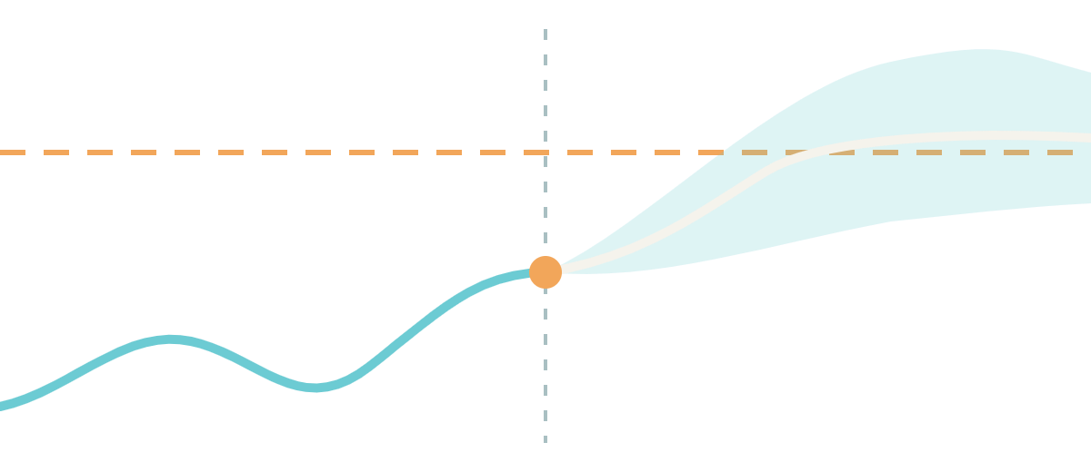
[Team name]
TEAM AND REPOSITORY
[College or incubator]
TEAM LEADER
MEMBER
MEMBER
MENTOR
[Leader name]
[Member name]
[Member name]
[Mentor name]
[Role]
[Role]
[Role]
[Affiliation]
Repository
github.com/[owner]/[TeamName_CollegeName]
Thank you · Questions welcome
Notes:
Thank you. Our work in three sentences. A twin that joins a patient’s record with their wearable stream. A forecast of glucose excursions two hours ahead, with reasons a doctor can read. And an evaluation that is honest about its limits. Everything is in our public repository: the code, the README with the licences, the architecture diagram, this presentation and the video. We are happy to take questions. [Fill in the team names, roles, mentor and repository link before you present, and remove any card you do not need.]

